Slide 1


Slide 2
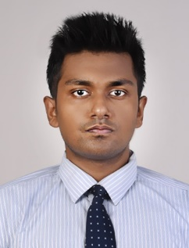
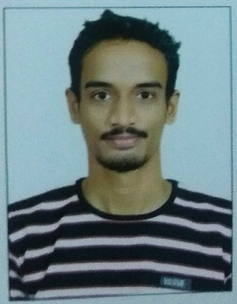
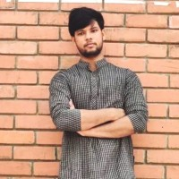
Project Highlights
Project Name : Employee Portfolio
Team Size :
BU Mentor Name : Raghavendra Prasad CS, Harshal Trivedi Mentor PS: 720960
Roshan Kochgawe
PS#
2009BLRICP01
B.Tech., EEE
Professional Skills
Rohan Neil Mendonca
PS#
2009BLRICP01
B.Tech., Branch
Professional Skills
Praveen Kumar Chaubey
PS# 99002503
2009BLRICP01
B.Tech., EEE
Flexibility and Adaptability

Slide 3
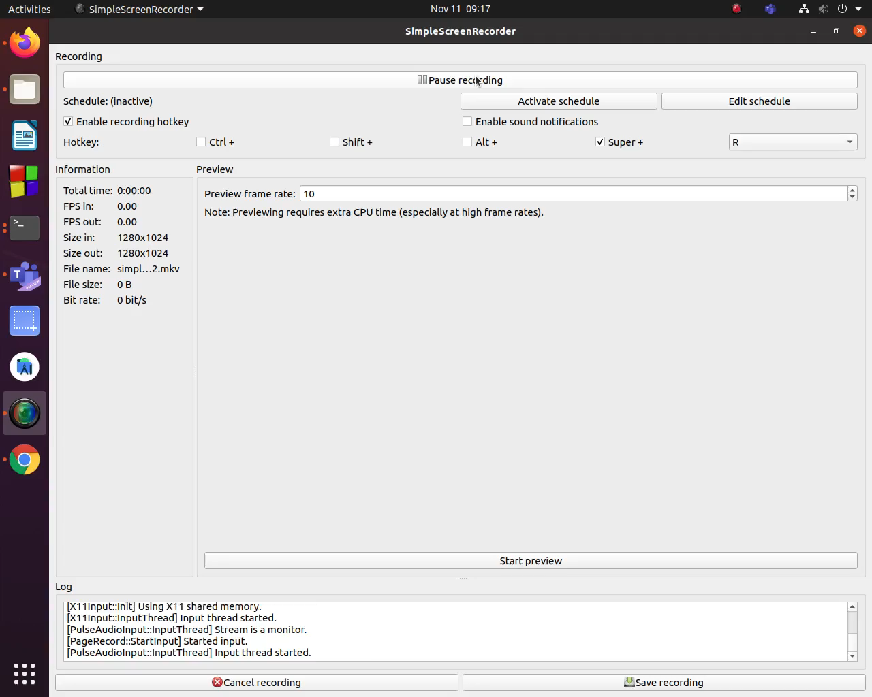
Project Video Snippet

Slide 4
Future development that can be implemented further
Make the Website much more responsive
Make it more aesthetic using bootstrap.
Add a dedicated backend with the supportive database

Slide 5


Thank You !

